Slide 1
SSW-555: Agile Methods for Software Development
Testing
Instructor: Dr. Nafiseh Ghorbani
Department of Systems and Enterprises
Stevens Institute of Technology

Slide 2
Acknowledge
https://www.cs.tau.ac.il/~nachumd/horror.html
https://www.guru99.com/software-testing-introduction-importance.html
https://www.tutorialspoint.com/junit/
http://junit.org/junit4/javadoc/4.12/org/junit/package-summary.html
https://docs.python.org/dev/library/unittest.html
http://www.softwaretestinggenius.com/all-about-system-testing-an-important-part-of-our-software-testing-effort
http://softwaretestingfundamentals.com/acceptance-testing/

Slide 3
Today’s Topics
Overview of testing
Definition
Testing stages
Comparing testing in traditional plan driven approach and agile approach
Test-First (or Test-Driven) Development
From Test-Driven to Behavior-Driven

Slide 4
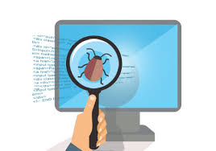
What is Software Testing?
The process of dynamically exercising a program, to determine whether a software system meets specific quality requirements such as conformance to specifications, performance, reliability, or robustness, etc.
Does the system do what it’s supposed to do?
Testing is the process of executing a program with the intent of finding errors.

Slide 5

Why is Testing Important?
Software failures can cause monetary and human loss…
https://www.cs.tau.ac.il/~nachumd/horror.html
https://www.guru99.com/software-testing-introduction-importance.html

Slide 6

Air Crash
A China Airlines Airbus A300 crashes on April 26, 1994
264 people killed

Slide 7
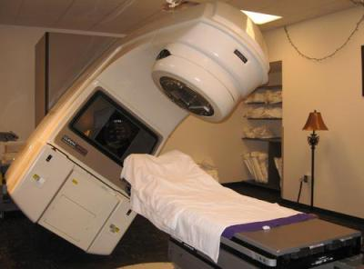
Therac-25 Failure
The Therac-25 radiation overdose due to software bugs
4 patients killed, 2 life-long injured

Slide 8

The Most Expensive Hyphen
1962, the Mariner I exploded less than 5 minutes into flight due to a tiny typo in mathematical code.
$ 80 million went to waste in 1962
≈ $724 million in 2021

Slide 9

U.S. Bank Accounts
May 1996, the bank updated its ATM transaction software with new message codes. The message codes were unfortunately not tested on all ATM protocols
823 customers paid $920 million

Slide 10

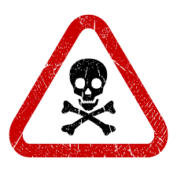
Software Testing is Important!
Software bugs could be expensive and dangerous!

Slide 11


Software Testing Methods
Black box testing: Examines the functionality of an application without peering into its internal structures or workings.
White box testing: tests internal structures or workings of an application, as opposed to its functionality.

Slide 12
Software Testing Phases
Unit Test: Test new features
Integration Test: Combine and test code of multiple developers
Regression Test: Verify that new changes haven’t broken previous working code
System Test: Test the entire system as a whole
Functionality, performance, stress, security
User Acceptance Test: Verify that the customers are happy!
Notes:
In software testing, regardless of the approach we are taking: traditional plan driven or agile approach, there are 5 different types of testing we need to do.
The first is unit testing. Here, developers test some new features.
Developers write and finish some code for implementing some user stories, a few functions and a few methods.
The he/she needs to test if these new code are doing what they are suppose to do.
The next phase is called integration testing.
Here we are combining the code from multiple developers or multiple modules from the same developers.
But the idea here is that we are taking multiple pieces of the system and making sure that they are working together properly.
The third is called regression test. We are verifying that changes we made recently don’t break something else.
For example, we had some code that works just fine, but we add some new features, or we just fixed some bugs, we want to verify that the new code or the updated code doesn’t break something else.
The next phase is called system test. All the code of the system is completed and merged together. It is time to test the complete system. Specifically, we are looking at testing the functionality.
Have we included all the functions that we promised to include?
We might be testing the performance of the system.
How our system respond to 5 users, 50 users, 500 users, or 5000 simultaneous users?
How the performance of the system and the system scale up with more users?
Stress testing means that you are testing your system under parameters beyond what your system is designed for.
Will you system fail gracefully?
Or does it just fall apart and stop responding to the users?
Sometimes, hackers find ways to get into your system when it is under stress.
Does the system protect our customers sensitive records?
Are normal users protected from abusive users?
Finally, we will talk about user acceptance testing. Here the real end users got a chance to try out the system developers built. Have we met the needs of the end users? Does it do what the users expect it to do ? Does it do what the users paid us to develop?

Slide 13
Unit Testing (xUnit)
Framework for unit tests, e.g. jUnit, PyUnit(unittest)
Tests are written as class methods
Developers appreciate that tests are code
Test code is separate from production code
There are similar xUnit frameworks and tools for many other programming languages
CUnit
CppUnit
csUnit
...

Slide 14
Architecture of a Test
1. fixture – creates objects and context for test
2. exercise – invokes methods under test
3. result – asserts equality (or something else) about the results of the exercise
Assert equal, not equal, close, membership, etc.

Slide 15
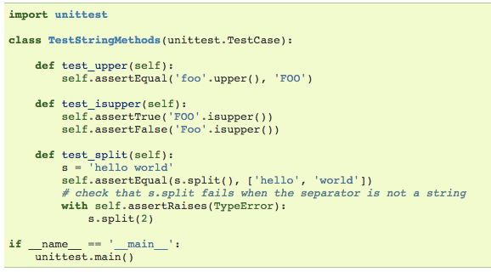
Simple Python Unittest

Slide 16
Simple Python Unittest
1. Import unittest module that provides classes for supporting tests

Slide 17
Simple Python Unittest
2. Derive a test class from unittest.TestCase. The test class name is arbitrary

Slide 18
Simple Python Unittest
3. Define a set of methods for each Test case.
Each test case contains calls to unittest.TestCase.assert*()
Method name should begin with ‘test_’

Slide 19
Simple Python Unittest
4. Call unitttest.main() to automatically invokes all methods in test class

Slide 20
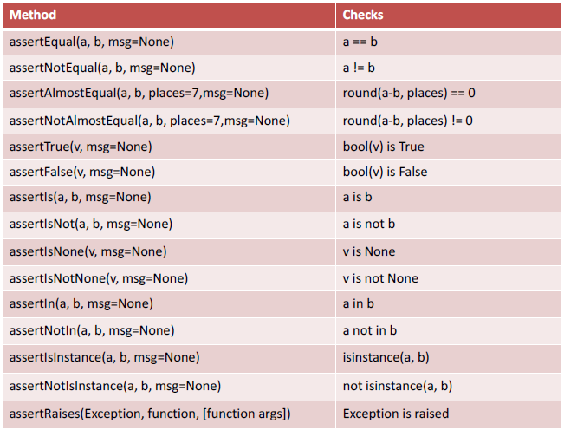
Python unittest Assert Methods
https://docs.python.org/dev/library/unittest.html

Slide 21
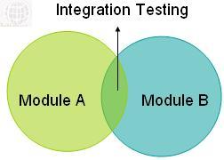

Integration Testing
The purpose of integration testing is to verify the functional, performance, and reliability between the modules that are integrated.

Slide 22
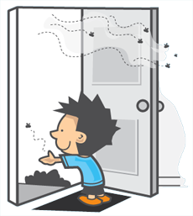
Regression Testing
Verifies that software, which was previously developed and tested, still performs correctly after it was changed or interfaced with other software.
Changes may include software enhancements, patches, configuration changes, bug fixes, etc.
Techniques:
Retest all
Test selection
Test prioritization

Slide 23
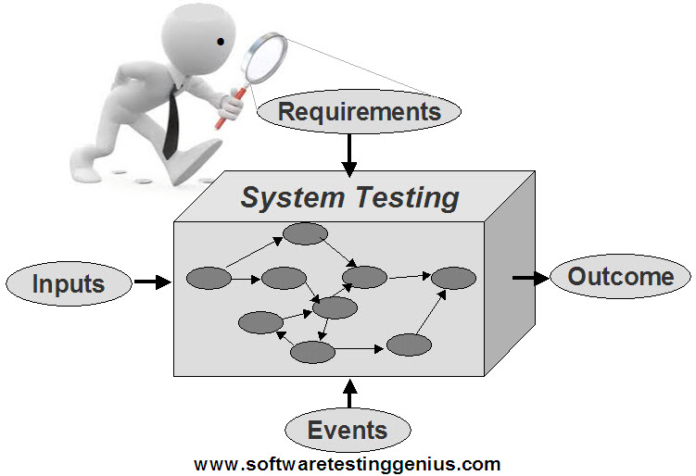
System Testing
System Testing (ST) is a black box testing technique performed to evaluate the complete system the system's compliance against specified requirements.
In System testing, the functionalities of the system are tested from an end-to-end perspective.
Functionality
Performance
Scalability
Stress
Reliability
http://www.softwaretestinggenius.com/all-about-system-testing-an-important-part-of-our-software-testing-effort

Slide 24
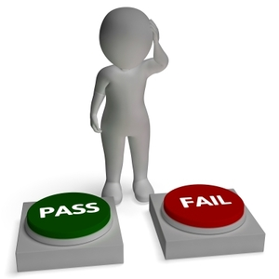
Acceptance Testing
Formal testing with respect to user needs, requirements, and business processes conducted to determine whether or not a system satisfies the acceptance criteria and to enable the user, customers or other authorized entity to determine whether to accept the system.
http://softwaretestingfundamentals.com/acceptance-testing/

Slide 25
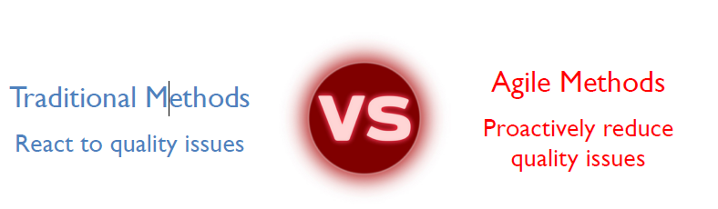
Software Testing Comparison

Slide 26
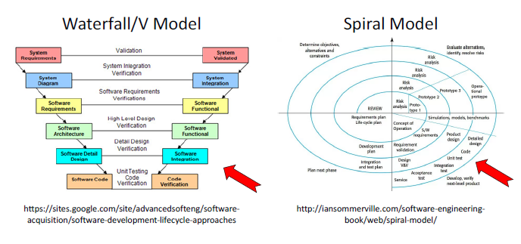
Traditional Software Testing
Notes:
In both the v model and spiral model, we have the formal and sequential stages of the testing on after another.

Slide 27
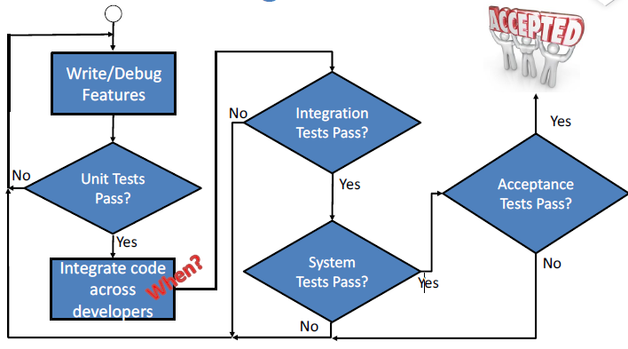
Traditional Testing Flow

Slide 28
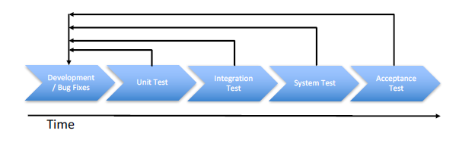
Traditional Testing
Testing is blocked until development is “complete”
Testing is performed by a separate test team
Developers might not be trusted to test their own code
Testing schedule may be compressed if development schedule slips

Slide 29
Agile Testing
Testing is NOT a separate phase with Agile Methods
Instead, testing is integrated into every step
Focus on automated testing and continuous integration
Find problems as quickly as possible
Expect frequent changes, so facilitate them
Agile testing is not just a passing phase…

Slide 30
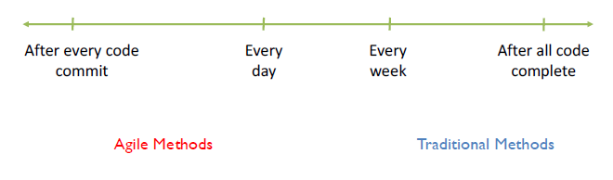
When to integrate?
Integration combines code from multiple developers
How frequently? Continuously? Periodically?

Slide 31
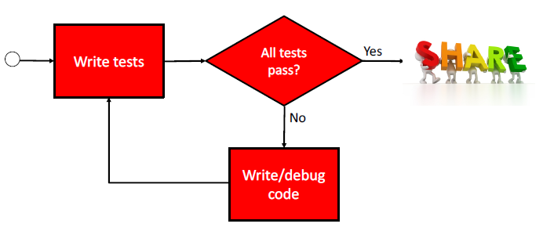
Agile Testing Flow: Automated and Continuous

Slide 32
Unit Testing
 | Traditional | Agile
Who? | Developers | Developers using automated Testing platforms
What? | New features or bug fixes; Code/branch coverage | New features or bug fixes code/branch coverage
When? | After code complete; Before integration | Tests written before code is written; Run tests while developing code

Slide 33
Integration Testing
 | Traditional | Agile
Who? | Developers and/or testers | Developers using automated testing platforms
What? | Test multiple modules from potentially different developers | Test all modules from all developers
When? | After unit test is complete on relevant modules | Continuously: at least once per day if not on every code check in using existing tests

Slide 34
Regression Testing
 | Traditional | Agile
Who? | Testers (Not the developers) | Developers using automated testing platforms
What? | Integrated modules | Entire system or selected components
When? | After changes to code for bug fixes or new features | After changes to code for bug fixes or new features

Slide 35
System Testing
 | Traditional | Agile
Who? | System Test Team (not the developers) | Developers using automated testing platforms
What? | Test complete system Performance, security, stress testing | Test complete system Performance, security, stress testing
When? | After all code modules are complete and tested | Optional: may be done before product release cycle after several sprints

Slide 36
Acceptance Testing
 | Traditional | Agile
Who? | Customer test engineers | Product Owner, Stakeholders
What? | Complete system based on requirements | Overall system, Including new features from latest sprint
When? | After system test, frequently before final payment | Sprint Review

Slide 37
Customer Bug Reports?
Agile Methods’ focus on automated testing and continuous integration helps to reduce, but doesn’t eliminate bugs found by customers
Scrum adds new features each sprint
How are bugs tracked?
When are bugs fixed?
Add bugs as user stories to the product backlog
Product owner prioritizes new features and bug fixes

Slide 38
Test-First or Test-Driven Development (TDD)
Motivation:
Programmers don't write tests because:
They don't like to
They don't have time
They have "more important" things to do
Result:
Code breaks
Debugging reduces productivity and doesn’t improve testing
Still no tests
Notes:
We now know that testing is an integral part of agile development, it is not a separable phase.
The very popular methods in agile methods is test first or test driven development (TDD).
The motivation is that: developers don’t like to write tests. There are many excuses for this.
For example, I just don’t really like writing test cases, it is not as much fun as writing new features.
I don’t have time for it. I have more important things to do.
But this type of attitude is causing problems in plan driven approaches as well as agile methods.
As a result, code breaks, it doesn’t do what it is suppose to do.
Debugging turns down our productivity and doesn’t really improve our testing.
We didn’t do anything to improve our testing process. We still have no tests.

Slide 39
Alternative TDD Scenario
Write tests first
Run the tests (they will probably fail)
Write some code
Rerun the tests
Debug until the tests pass
Relatively little untested code at any one time so bugs are likely to be in the most recent code
Notes:
An alternative is to write test first.
We write test first.
The we run the test.
Of course, it will fail, because we have done nothing in the source code.
But when it fail, we will write something in the code.
And run the test, and debug, until all the tests pass
The advantage is that there is relative little untested code.
If you see a bug, it is most likely that the bug is related to the part of code that I am working now.
I still have fresh mind for what I have done.
It helps us to build better code and make changes more easily because we’ve already written the test cases for the new change and we don’t have to worry about wring new tests anymore. We may need to add new cases, but we got the bulk of test cases.

Slide 40
TDD Provides Useful Feedback
Programmers get feedback when their tests pass
Programmers get feedback when their tests fail
Customers get feedback when the tests pass or fail
Provides insights on how the developers are doing
Provides frequent metrics for management
Notes:
The developers are more confident that their code is right because relevant tests are passing.
How many test cases we have, how many are passing and how may fail. We have it any time of the project, it doesn’t have to wait until the end of the project.
In plan driven, you don’t know how you project is doing until the end it is delivered to the customers.

Slide 41
Pace
Write a few tests
Write a few lines of code
Don't write too many tests at once
Don't write too much code at once because it’s harder to debug until you know it works properly
Notes:
How do we do this, what is the pace to do this?
Because it is harder to debug.

Slide 42
From TDD to BDD (Behavior-Driven Development)
Customers and some developers have trouble defining tests:
Where to start?
What to test?
What to call the tests?
How can we improve the test process to include the customer?
Change the syntax and simplify the process!

Slide 43
Test-Driven Development (TDD)
Focus: TDD focuses on writing tests before writing the actual code. It's primarily about ensuring that the code works as expected by creating automated unit tests first.
Approach:
Write a test that defines a small piece of functionality.
Run the test, which should fail initially.
Write the minimum code necessary to make the test pass.
Refactor the code to improve it, ensuring that the test still passes.
Repeat this cycle for each small feature or piece of functionality.

Slide 44
Test-Driven Development (TDD)
Test Scope: The tests in TDD typically focus on the unit level, which means testing individual methods or functions in isolation.
Goal: TDD's goal is to have a green bar (i.e., all tests pass) continuously throughout development, ensuring that the code is tested and works as expected.
Tooling: TDD relies heavily on unit testing frameworks such as JUnit, NUnit, or pytest.

Slide 45
Behavior-Driven Development (BDD)
Focus: BDD focuses on improving communication between developers, testers, and non-technical stakeholders. It emphasizes behavior from the user's perspective, making sure the system behaves as expected from a functional viewpoint.
Approach:
Define behaviors that describe how the system should behave from the user's perspective, often using plain language.
Write scenarios in a Given-When-Then format (e.g., "Given a user is logged in, when they click on the logout button, then they should be logged out").
Automate the scenarios using tools like Cucumber or SpecFlow to execute and validate the behaviors.

Slide 46
Behavior-Driven Development (BDD)
Test Scope: BDD tests focus on higher-level features or user interactions, rather than individual units. It's more concerned with integration and how the software behaves from the end-user's perspective.
Goal: BDD aims to ensure the software's behavior is consistent with the expectations of both the business and technical teams. It's about aligning technical and non-technical stakeholders on how the system should work.
Tooling: BDD uses specialized frameworks such as Cucumber, SpecFlow, or Behave that allow tests to be written in natural language (e.g., Gherkin syntax), making them readable by all team members, including non-technical stakeholders.

Slide 47
Key Differences
Focus: TDD focuses on writing tests first and ensuring that the code works at the unit level, while BDD focuses on defining system behaviors that meet business requirements and user needs.
Test Level: TDD generally works at the unit level, whereas BDD is concerned with higher-level features and behaviors.
Audience: TDD is more developer-focused, while BDD involves collaboration with stakeholders, including testers and business analysts, ensuring that the product meets user expectations.
Language: BDD uses natural language (like Gherkin) for writing tests, which makes it accessible to non-developers, while TDD uses more technical terms in the test code.
In summary, TDD is more about testing code in isolation and ensuring it functions as expected at the unit level, while BDD is about validating behaviors from the user’s perspective and ensuring the software meets business goals.

Slide 48
Simplify Testing
Replace source code with natural language descriptions
Eliminate the word "Test"
Change from:
public class CustomerLookupTest extends TestCase {
testFindsCustomerById() { ... }
testFailsForDuplicateCustomers() { ... }
...
}
To:
CustomerLookup
finds customer by id
fails for duplicate customers
…

Slide 49
Map User Story to Tests
As a [X]
I want [Y]
so that [Z]
As a customer,
I want to withdraw cash from an ATM,
so that I don’t need to wait in line at the bank.

Slide 50
Behavior Templates Aid Testing
Given some initial context (the givens),
When an event occurs,
Then ensure some outcomes.
Given the account is in credit
And the card is valid
And the dispenser contains cash
When the customer requests cash
Then ensure the account is debited
And ensure cash is dispensed
And ensure the card is returned
Pre-conditions
Event
Post-conditions

Slide 51
User Stories to Behavior Stories
Behavior stories are still easy for customers to write and understand
Describe what needs to happen
BUT…
Behavior Stories are easier to map automatically from user descriptions to executable test cases

Slide 52
BDD Tools
JBehave: JUnit for customers
RBehave: JBehave in Ruby
Behave: Behave for Python
RSpec: Evolution of RBehave
Cucumber: UI specs in natural language for Ruby
... similar tools for Python, C, C++, Delphi, PHP, .Net

